Slide 1

Presentation on
VIDYAVARDHAKA POLYTECHNIC MYSORE
Gokulam III Stage Mysore
SMART SHOES FOR VISUALLY IMPAIRED
Subtitle: Continuous Internal Evaluation – I
Presented by: AMULYA S GOWDA 488CS23001
GANDHARAVA RAJ N 488CS23018
HARSHITHA C 488CS23022
JEEVAN L 488CS23029
Batch-[03]

Slide 2
Project Scope Document
Objective:
To design and develop smart shoes that assist visually impaired individuals in safe and independent navigation.
To detect obstacles in real time using ultrasonic sensors and provide feedback through vibration and sound alerts.
Goals:
Improve mobility and confidence of visually impaired users.
Reduce accidents caused by unseen obstacles.
Provide an affordable, lightweight, and wearable assistive solution.

Slide 3
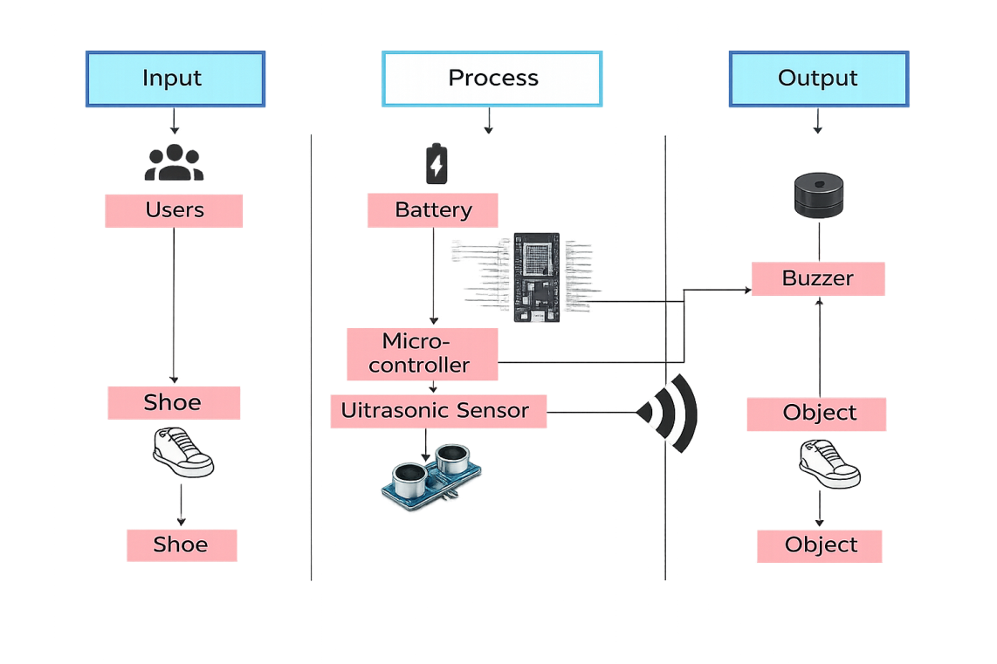
Deliverables:
Obstacle detection system using ultrasonic sensors.
Vibration motor and audio alert mechanism.
Constraints:
Compact size and weight restrictions for comfortable arability.
Battery life is limited and needs regular charging.
The system should be easy to use and reliable.

Slide 4
Work Breakdown Structure (WBS)
Phases and Tasks:
Requirement Analysis:
Identify the needs of visually impaired users through surveys and consultations.
Design Phase:
Hardware: Ultrasonic sensor, vibration motor, buzzers.
Software: Adruino IDE, Firmware for sensors and output control.
Implementation Phase:
Program the microcontroller using Adrunio IDE.
Ensure proper wiring, insulation, and power distribution.
Testing and Validation:
Test obstacle detection accuracy under various lighting and terrain conditions.

Slide 5
Time Line Schedule
WEEK | TASK
Week 1 | Requirement gathering and literature review.
Week 2 | Literature survey, study of existing smart shoes and finalize features.
Week 3 | Prepare system architecture, block diagram, and design planning.
Week 4 | Select and purchase components .
Week 5 | Assemble hardware, connect ultrasonic sensors, vibration motor, wiring.
Week 6 | Develop software code for obstacle detection and alerts.
Week 7 | Integrate hardware with software, testing, debugging.
Week 8 | Final testing and feedback from users.
Week 9 | Prepare documentation.
Week 10 | Submit the final project.

Slide 6
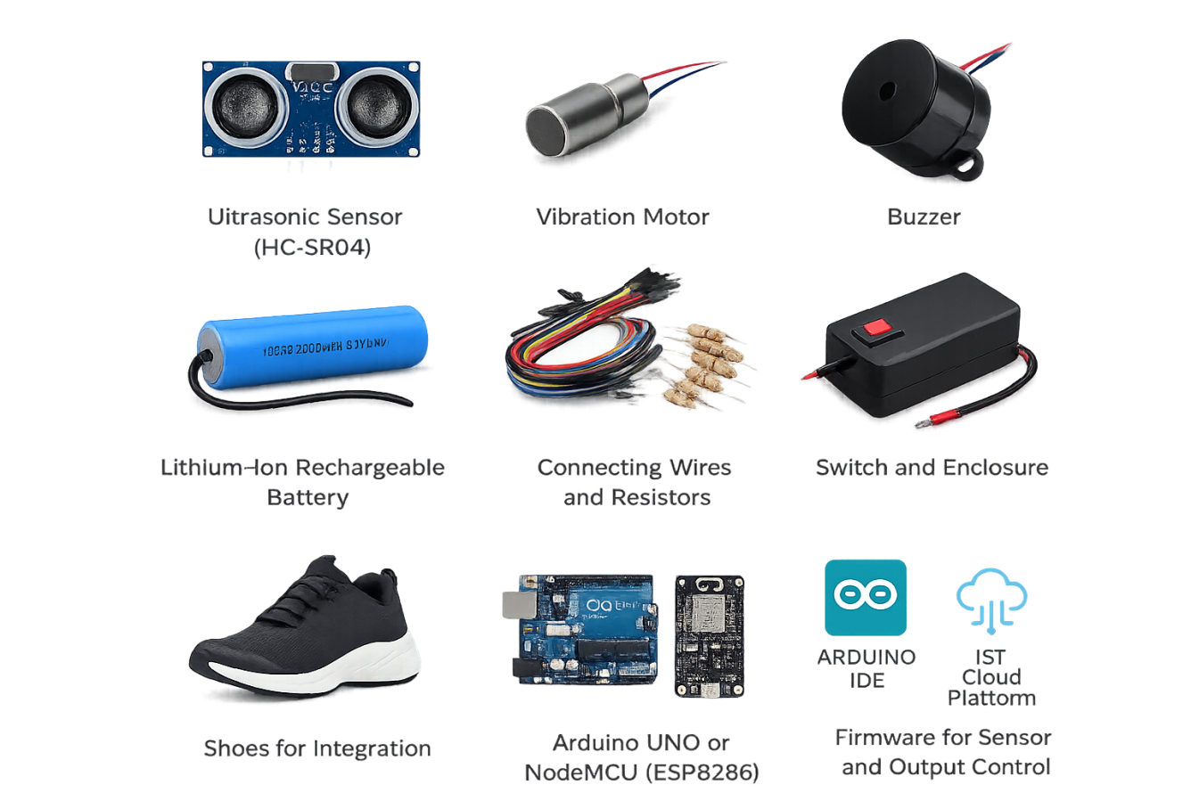
Components
Hardware Requirements:
  Ultrasonic Sensor (HC-SR04)
  Vibration Motor
  Buzzer
  Lithium-ion Rechargeable Battery
  Connecting Wires and Resistors
  Switch and Enclosure
  Shoes for Integration
  Arduino UNO or NodeMCU (ESP8266)
Software Requirements:
  Arduino IDE
  IoT Cloud Platform
  Firmware for Sensor and Output Control

Slide 7
Cost Breakdown Structure (CBS)
Component | Quantity | Unit Cost (RS) | Total Cost (RS)
Ultrasonic Sensor | 1 | ₹250 | ₹250
Vibration Motor /Buzzer | 2 | ₹280 | ₹560
Battery | 2 | ₹360 | ₹720
Micro-Controller | 1 | ₹660 | ₹660
Total | 4 | ₹1550 | ₹2190

Slide 8
Risk Analysis
Risk | Likelihood | Impact | Mitigation Strategy
Sensor failure | Medium | High | Use multiple sensors, regular testing, auto error alerts
Hardware damage due to water/dust | Medium | Medium | Waterproof casing, dustproof design
User not trained to use system | Medium | High | Provide user training, voice instructions, simple interface
Connectivity issues | Medium | Medium | Offline working mode, local alerts without internets

Slide 9
Methodology
Development Approach:
Sprints:.
Detection: Ultrasonic sensors detect obstacles within a specific range.
Processing: Microcontroller processes data and determines distance.
Key Phases:
Ultrasonic Sensors: This are the core components responsible for detecting obstacles by measuring reflected sound waves.
Vibration Motor/Buzzer: This components provides haptic or auditory feedback to the user when an obstacle is detected.

Slide 10
Literature Survey
Existing System:
Research Papers:
Source | Parameter | Existing System | Observed Issue
JMRR 2023 – IoT Based Smart Shoe | Navigation Aid | Blind stick & manual assistance | Requires physical contact & does not provide early obstacle detection
JMRR 2023 – IoT Based Smart Shoe | Obstacle Detection | Traditional non-IoT aids | Lack of real-time sensing increases risk of accidents
Author & Year | Title | Method Used | Data Sets | Key Findings
S Santhi Priya & Maruthi B 25 Feb 2024 | Smart Shoe For Blind People | NodeMCU ESP8266 for processing | Existing mobility methods | Ultrasonic Sensors, Buzzer & Arduino Uno
Lavanya & Naveen Kumar Reddy Mar-Apr 2023 | Smart Shoes For Blind | Ultrasonic sensors in shoes | Piezo-electric power generation data | Ultrasonic Sensors, GPS, GSM Module & Arduino Uno

Slide 11
Conclusion
Key Highlights:
The Smart Shoes for Visually Impaired project demonstrates how modern IoT and embedded technologies can significantly enhance human life, especially for those with physical disabilities.
Future Scope:
AI and Machine Learning: Implementing object recognition and terrain classification to distinguish stairs, potholes, or moving obstacles.
Solar Charging: Integrating small solar panels for extended battery life.

Slide 12
Thank You

